Slide 1
GFM Autotuning

Slide 2





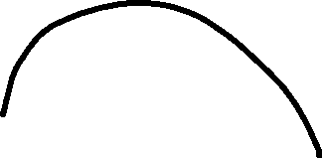

















States
friction
noise
inertia
Tune vel

Slide 3
States
0 - Noise Detection
1 – static friction
2 – inertia estimation
3 – inertia estimation
stopping

Slide 4
Noise id
Torque null
Max(abs(vel)) per timeId seconds

Slide 5














Static friction

Slide 6

































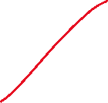




























Inertia

Slide 7
Velocity

